Slide 1
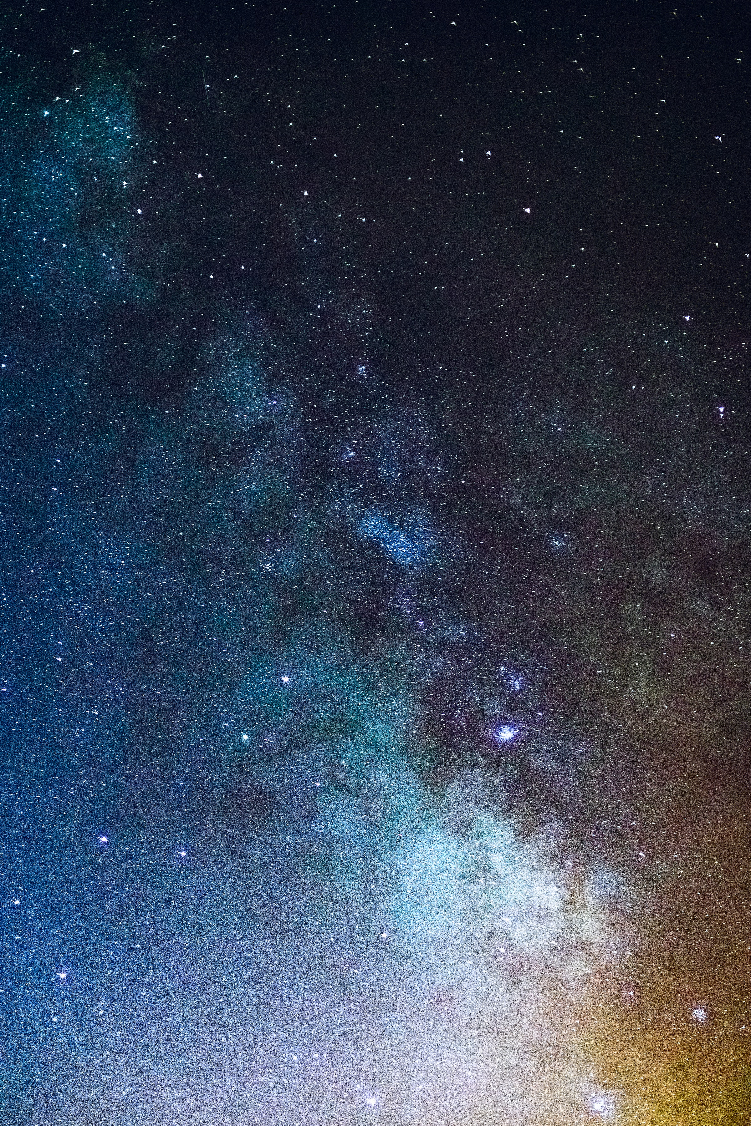
18-February-2022
2022 Game Day Analytics Challenge
Super Bowl LVI 2022
Who won the Battle of Ads ?
Team 1- Multiverse #Niha #Gaurav #Prajakta #Avnish

Slide 2
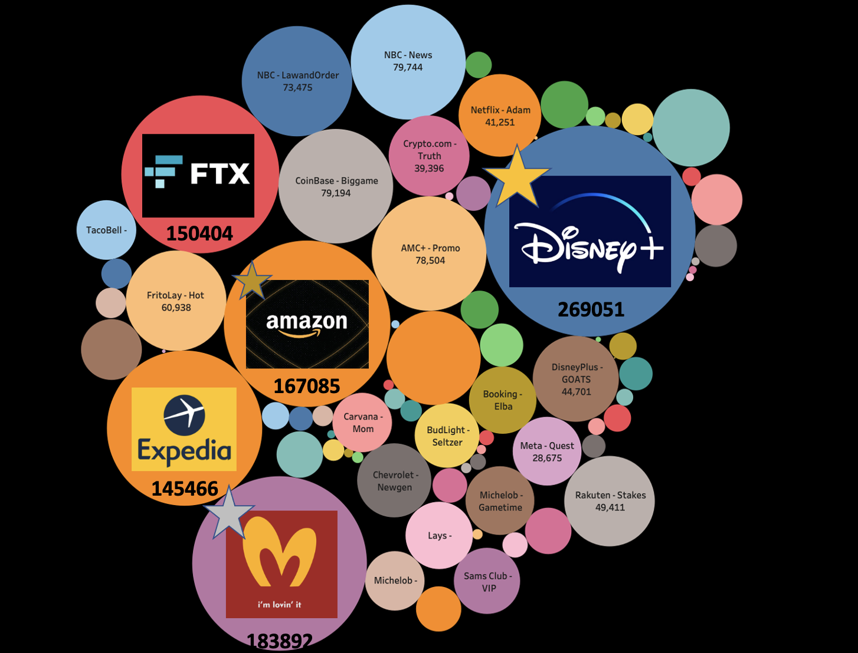
Buzz of the year!!
2.03 Million Tweets
76 Brands!
Disney+ Received
The
Highest
Amount
Of Tweets..

Slide 3

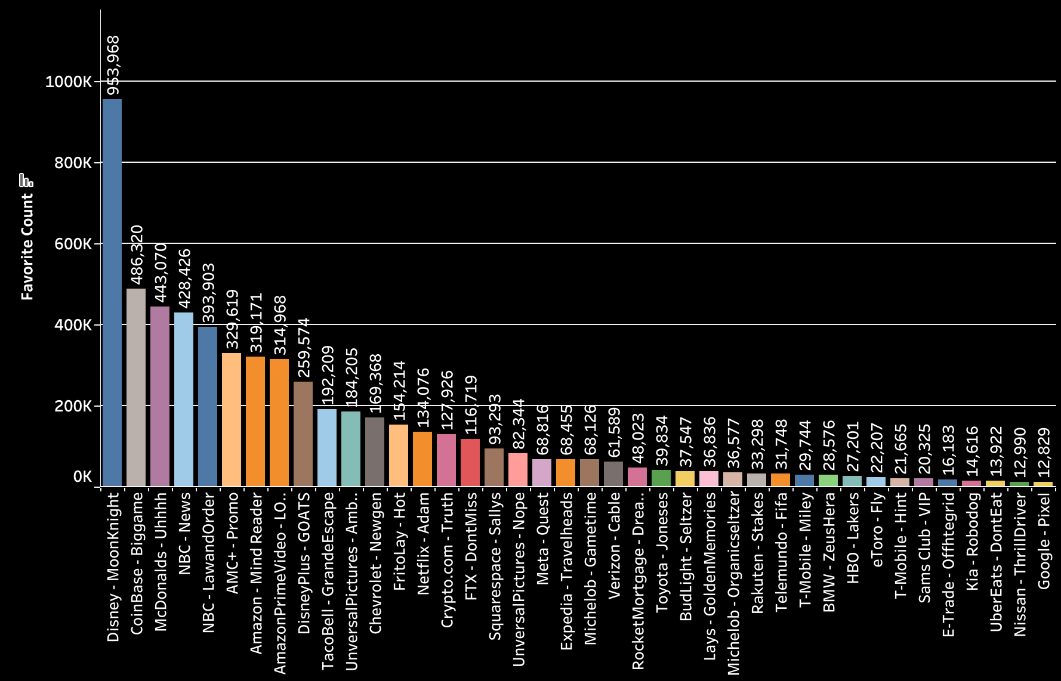
Who won the Million’s of Hearts?

Slide 4
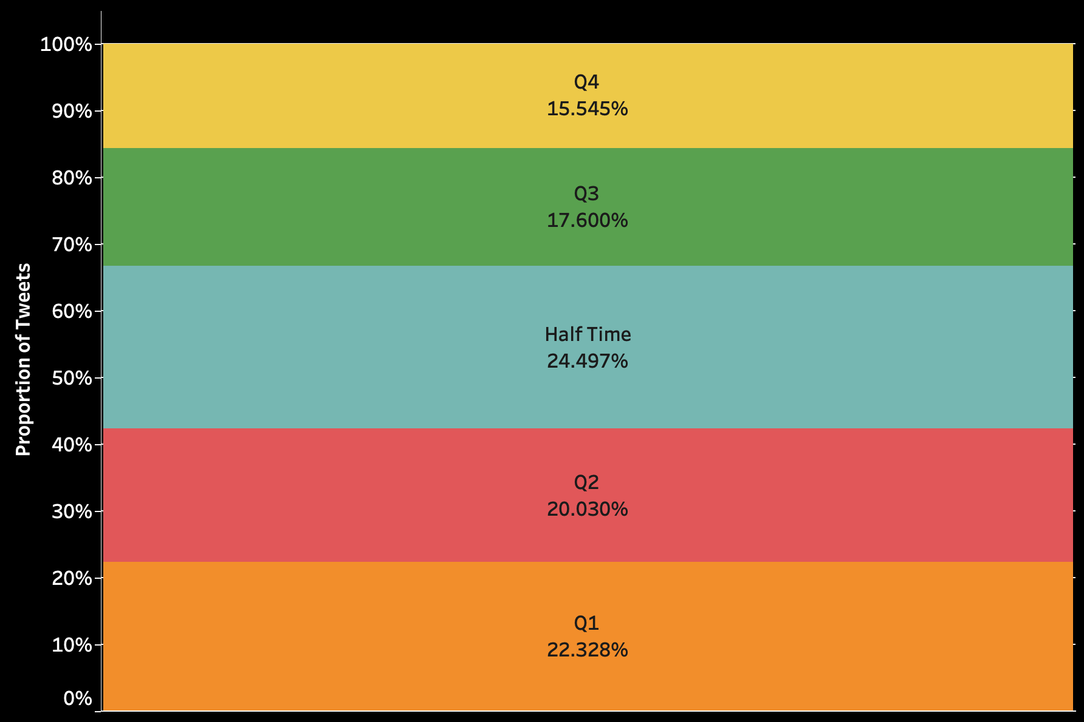

Half Time Prime Time!!
Number of tweets were
at peak at ‘Half time’ and
decreased as
the game went on..!!

Slide 5
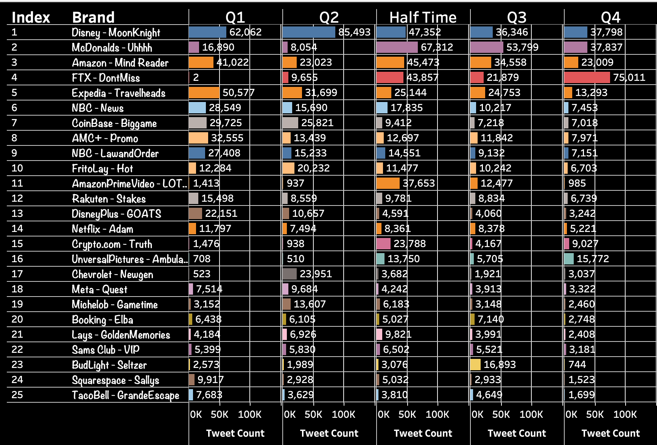

Slide 6
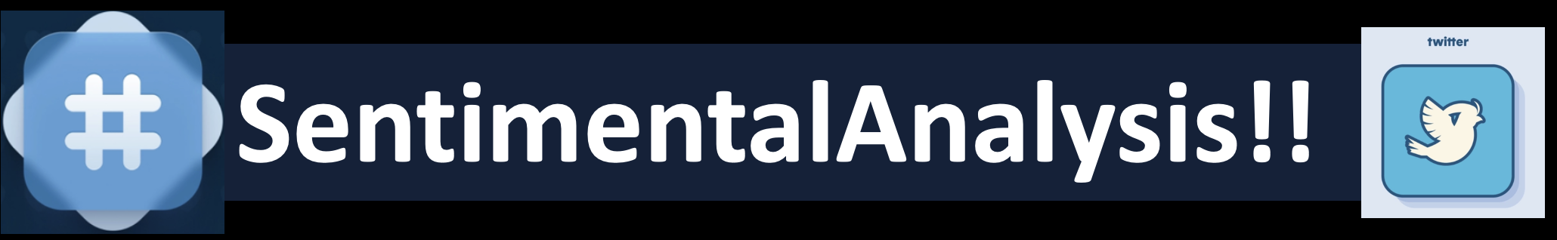
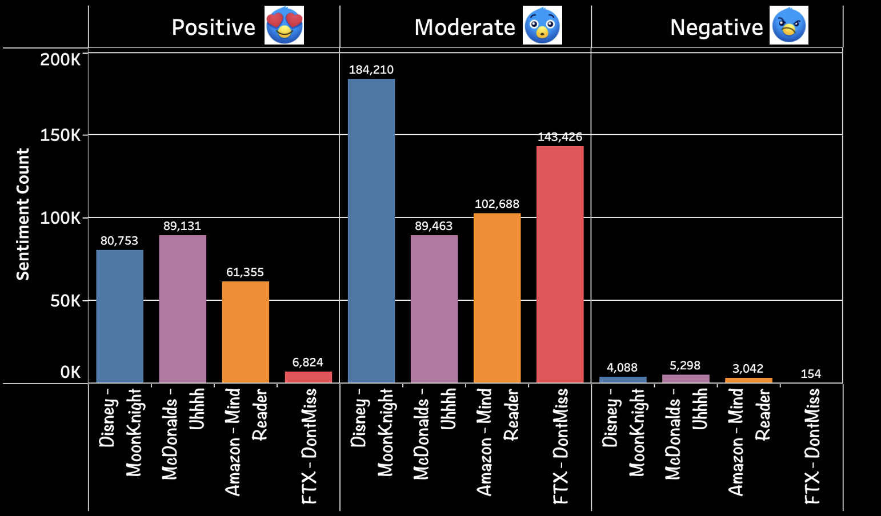
Positive, Moderate and Negative Tweets of the Top 4 Brands

Slide 7
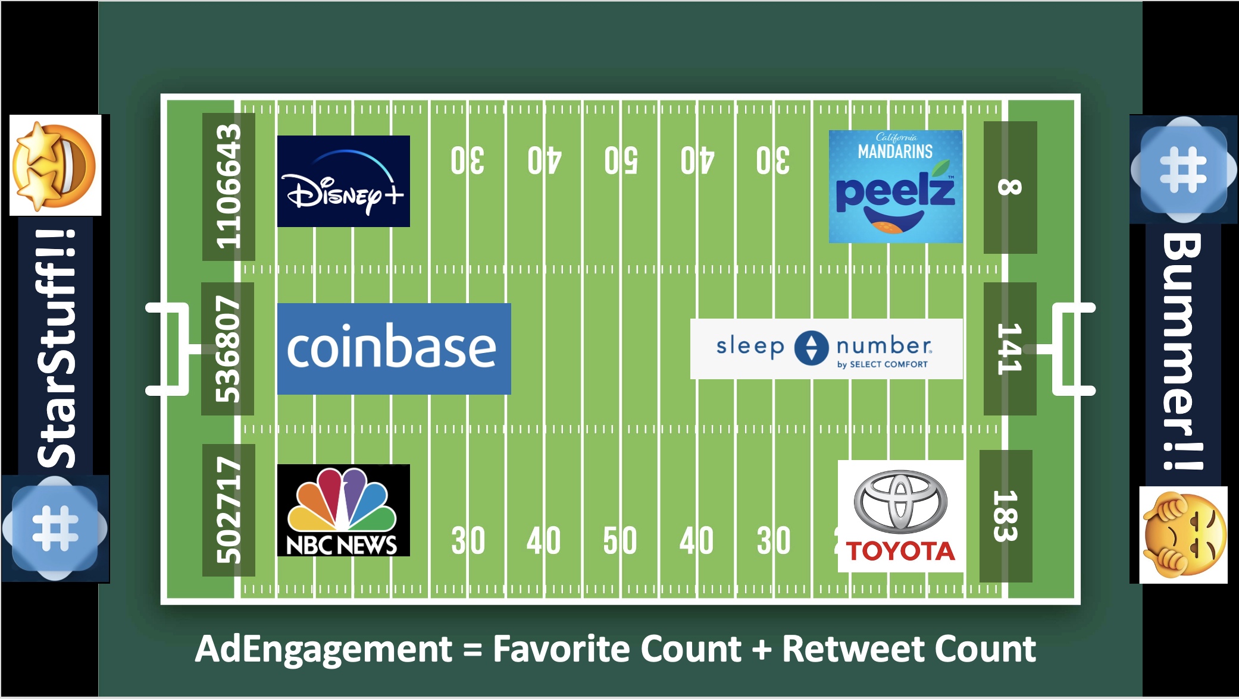
Ad Engagement

Slide 8
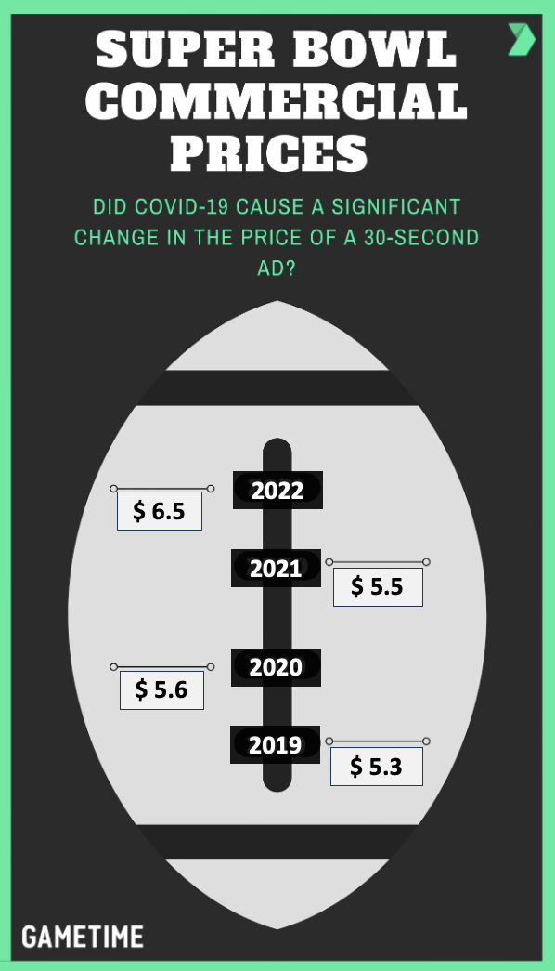
Where is all the Money ?
All Time High!!!
2022 $6.5 Million
Past years statistics of Tweets:
2021: $5.5 Million
2020: $5.6 Million
2019: $5.3 Million

Slide 9

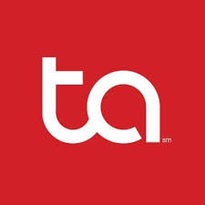





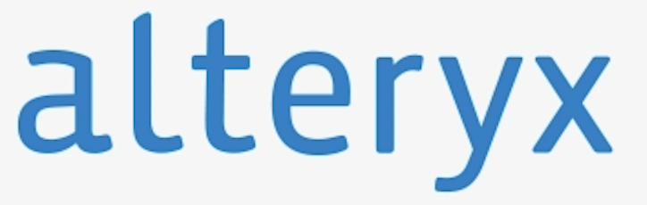
Thanking our sponsors

Slide 10
